Slide 1

Collectibles Exchange
BRAND GUIDELINES
FEBRUARY 2020
VERSION 1.0
C O L E X
Get Lifes Rewards.

Slide 2
WELCOME TO THE Colex BRAND
BRAND GUIDELINES
2
This guide provides a framework for how our brand should always look and feel no matter who touches it. In the following pages you will be guided through design elements – our logo, typeface, color palette, imagery and graphics.
Consistently using these elements will further define and differentiate us within our industry and outdoor recreation.

Slide 3
BRAND
BRAND GUIDELINES
4
SECTION TITLE

Slide 4
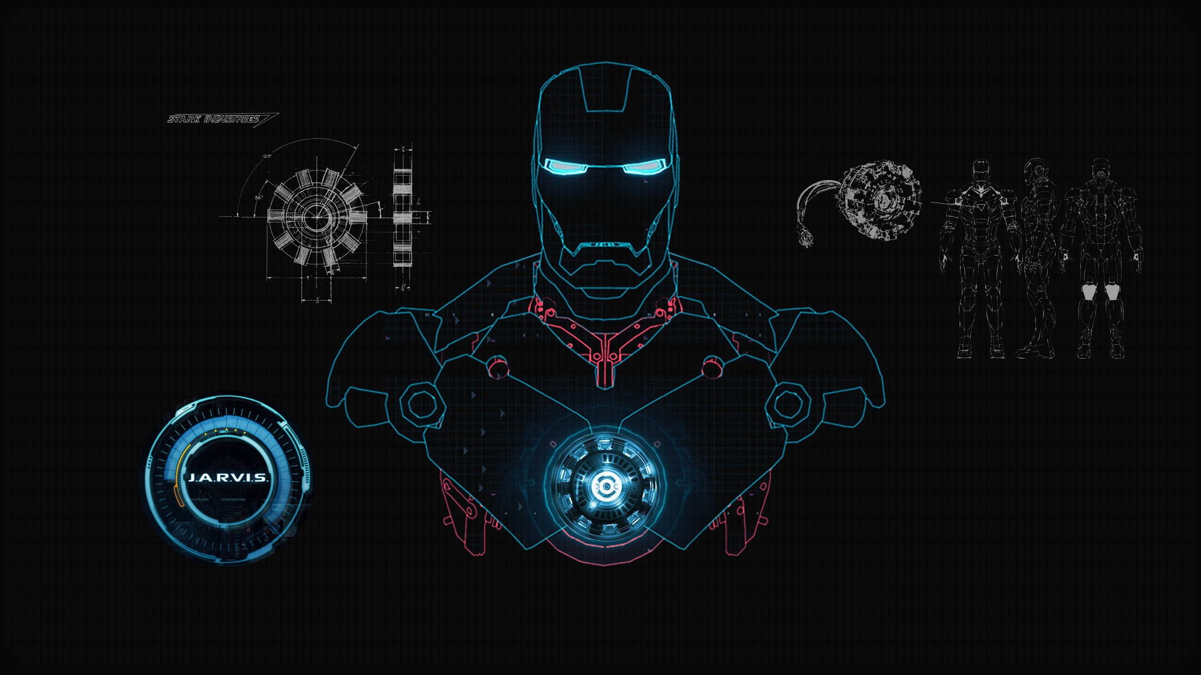
BRAND GUIDELINES
BRAND
5
OUR MISSION AT COLEX
Create a trusted marketplace that promotes information as a means to make the pursuit of life's rewards easy for its users.

Slide 5
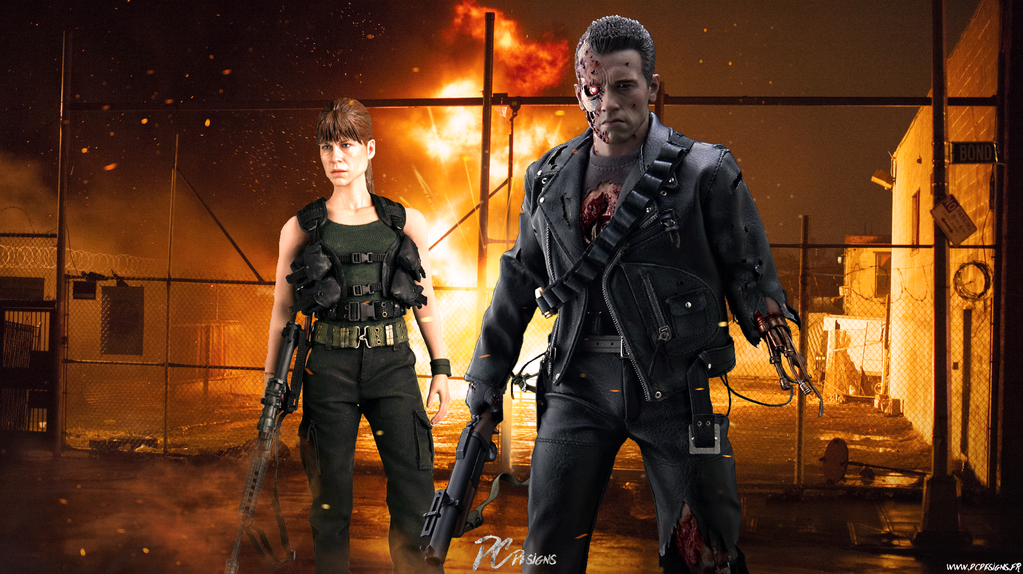
OUR VISION
Empower all people to experience the rewards of life.
BRAND
7

Slide 6

BRAND GUIDELINES
BRAND
9
OUR BRAND VOICE
Helpful
Smart
Fun
We want to convince people that we really do want to help them. Help them become more educated and therefore more successful.
We want to show people that we are a smart service for people that want an intellectual advantage. And nobody is doing this but US! so we are smart so we should not be afraid to show it.
We want to keep the fun in the hobby. After all this is all for enjoyment so we should try not to be too serious and have a positive and friendly attitude.

Slide 7
ELEMENTS
BRAND GUIDELINES
11
SECTION TITLE

Slide 8

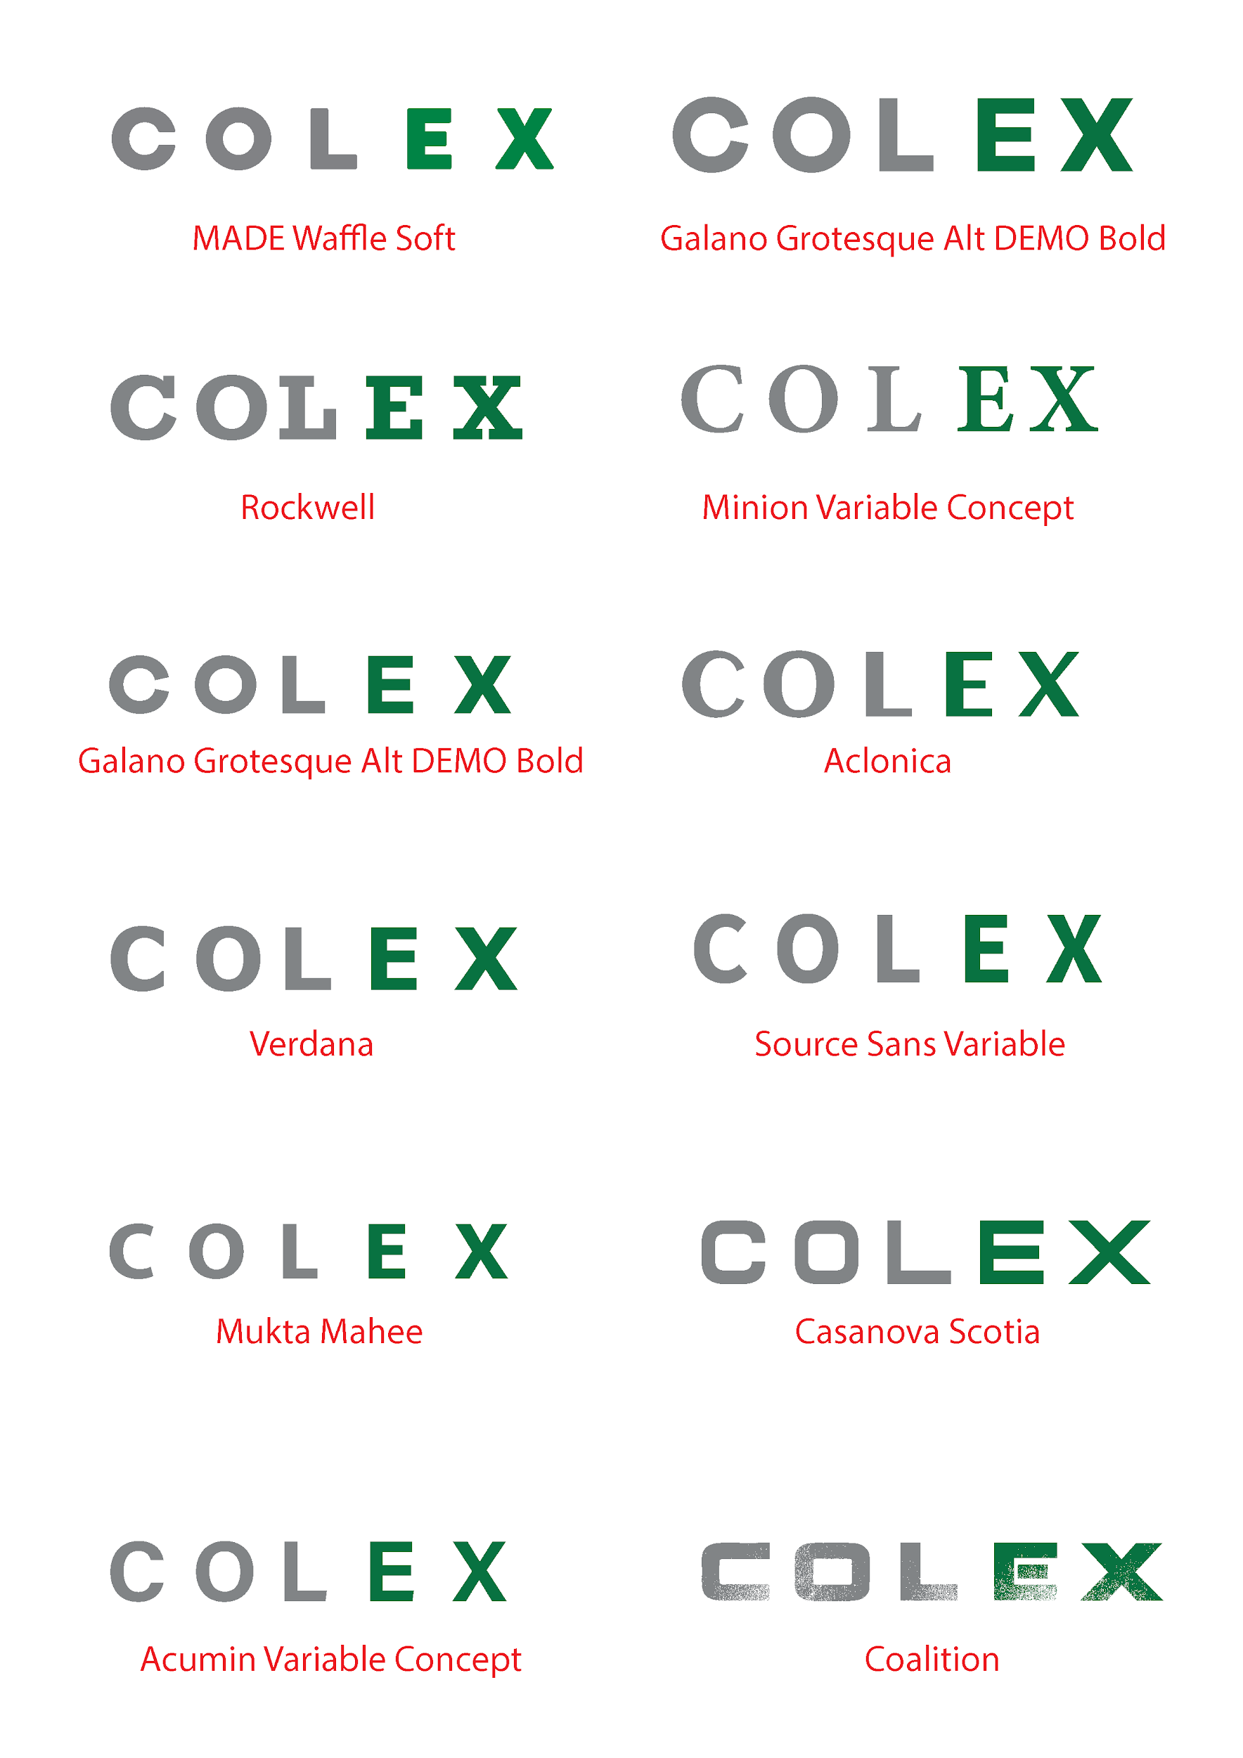









BRAND GUIDELINES
ELEMENTS
12
Logo
Our logo is the simplest, most immediate and recognizable representation of our brand. It builds upon our heritage, while communicating a modern and renewed energy for everything outdoors.
Logotype
The capital treatment of our word mark serves to anchor our symbol, creating a balanced
and complementary relationship, while still embracing its history. The rounded quality of our typeface reinforces the geometric qualities of our symbol.
Get Lifes Rewards.
Our brand green represents our attachment to nature and passion for bringing the customer to the outdoors.
Tagline
Symbol
Colex Logo

Slide 9




BRAND GUIDELINES
ELEMENTS
14
Logo Color
Full color
When possible, the full color Colex dark green and darkest grey version should always be used and placed behind a white or light colored background.
Get Lifes Rewards.
Reversed
When production or application needs require the logo to appear on a dark or colored background, a reversed version of the logo may be used. A white and green logo knocked out of Colex’s dark green is the preferred treatment.
Reversed
C O L E X
Get Lifes Rewards.
Black and white
When color reproduction is unavailable, a black or white version of the logo may be used. Always maintain sufficient contrast in order to preserve legibility of the logo.
Single color - dark grey
C O L E X
Note: Color variation applies to all forms of the colex logo.
Get Lifes Rewards.
Reversed
C O L E X
Get Lifes Rewards.

Slide 10
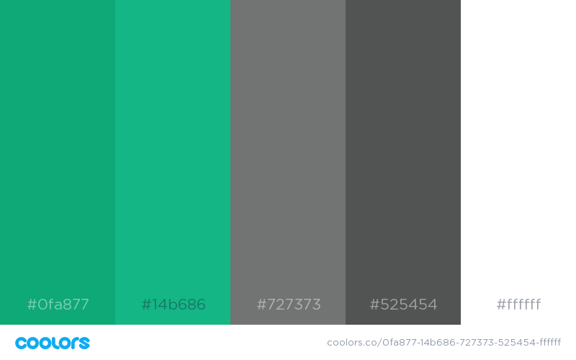

Slide 11
BRAND GUIDELINES
ELEMENTS
21
Typography
Orbitron ExtraBold
Orbitron Bold
Raleway Regular
When used correctly, typography has the
ability to convey image and feeling just as well as photography or graphics. Our headline typeface, Orbitron, is a versatile font with diverse weights, but our primary ones are ExtraBold, Bold and Regular.
The rounded qualities of the orbitron face
complement the geometry of our logo.
For body copy we use Raleway Regular, Italic
and Bold. This family works well across all applications of the brand.
Headlines
Raleway Regular Raleway Italic Raleway Bold
Online
Both of the Colex typefaces, orbitron and raleway, are web safe. They can be
downloaded and used for free across devices.
MONTSERRAT BOLD ALL CAPS
Note: Do not substitute any other typeface for
the approved colex font families.
Body copy
Callouts

